Slide 1
How to find professor’s contact information

Slide 2
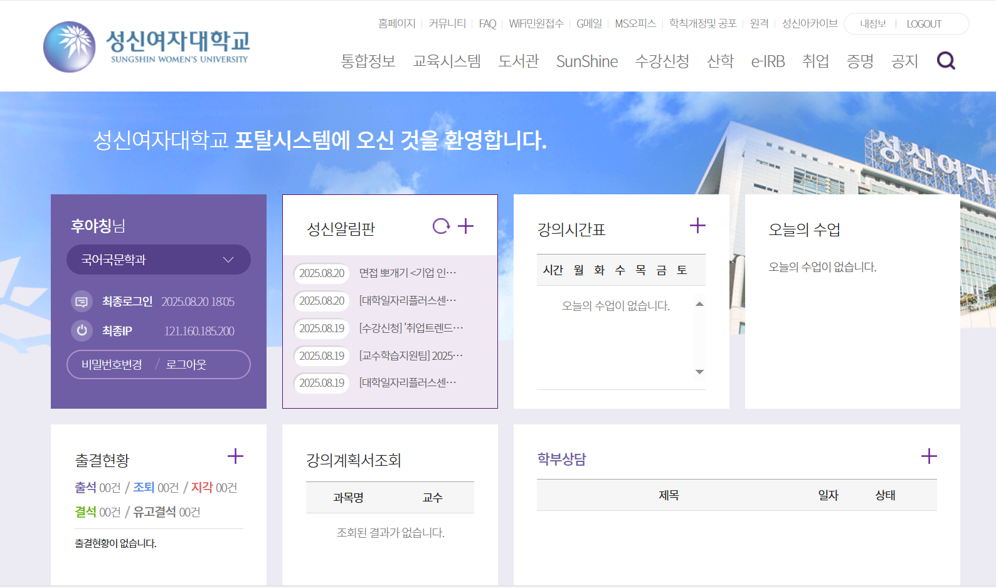
Method 1

Slide 3
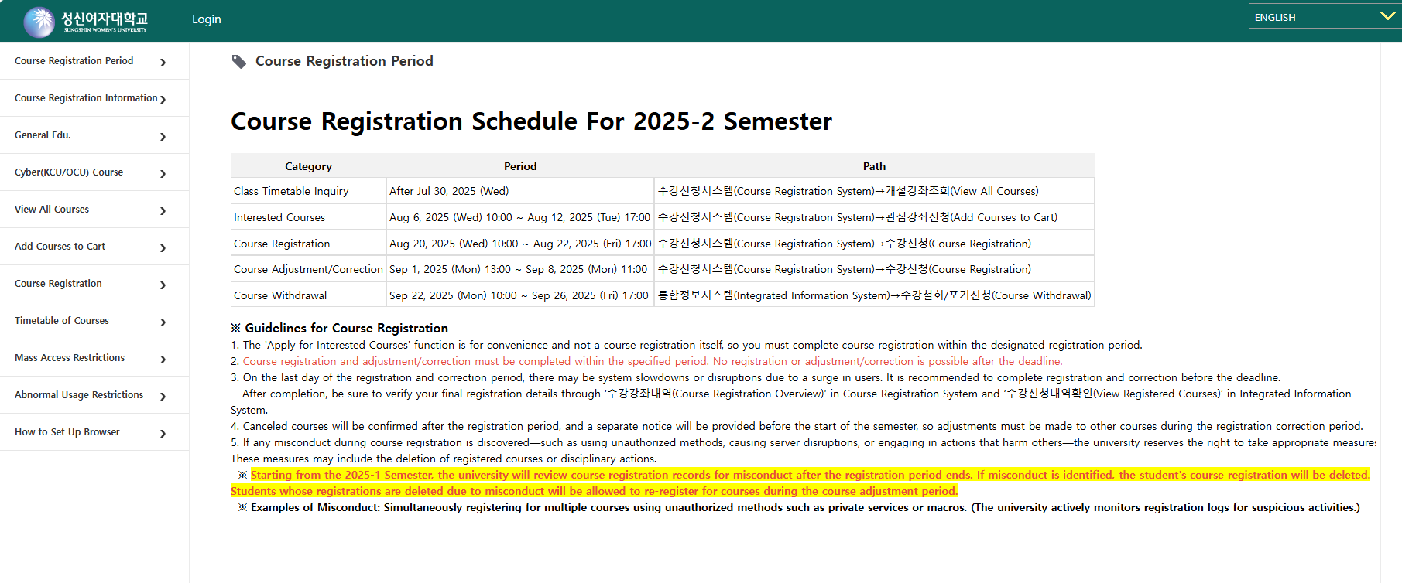
Click the login button to sign in.
(If you don’t log in, you may not be able to access the contact information.)

Slide 4
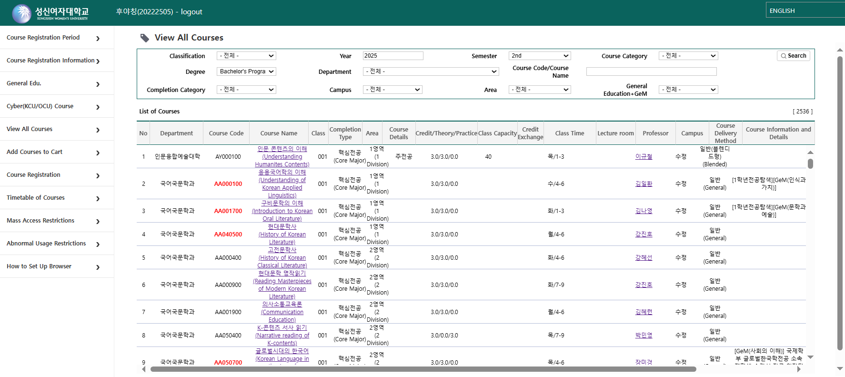
1. First, click on “View All Courses”
2. Enter your search criteria to find the class you want to register for.
3. In the course list, click the course title to view the syllabus.
2
1
3

Slide 5
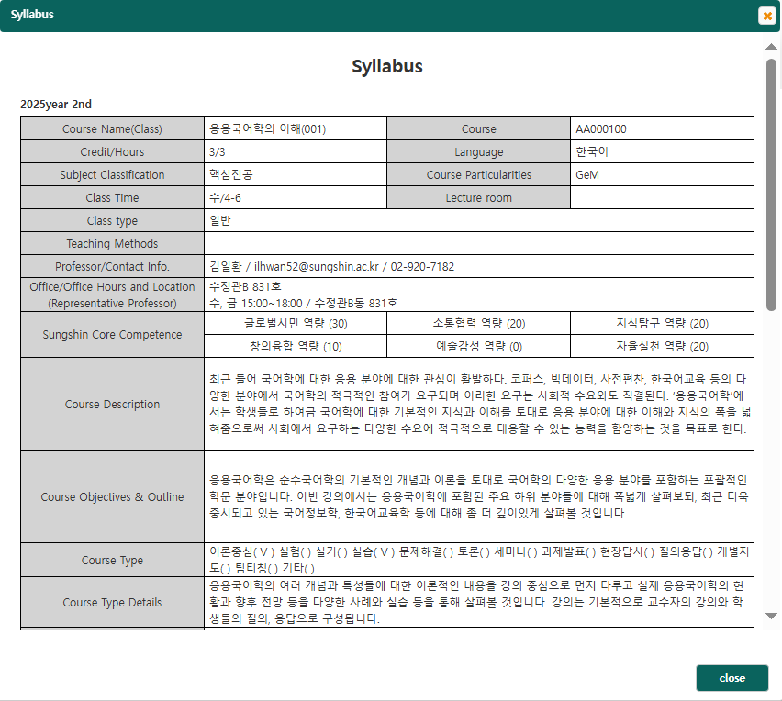
You can find the professor’s contact information on this page.
Various course-related announcements and messages are also available here.

Slide 6
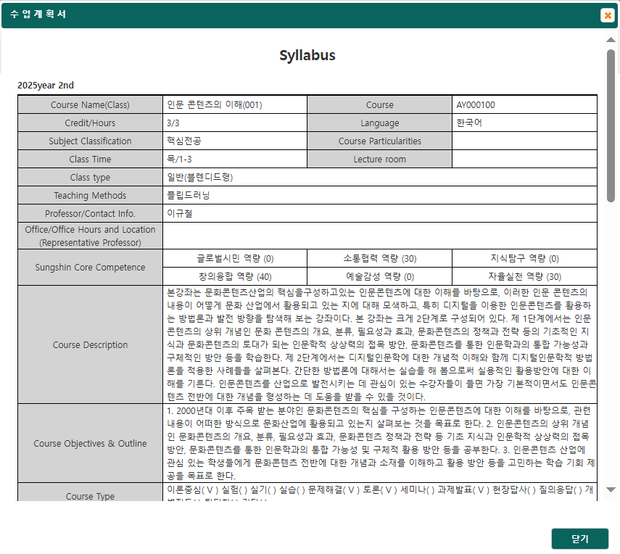
Method 2
In some course syllabus, the instructor’s contact information may not be provided.
If that’s the case, please refer to Method 2 below!

Slide 7
Return to the previous page, you can check the department offering the course.
Please note that the displayed from a specific college rather than a particular department so it may be better to copy and search the instructor’s name instead.
(If you know the exact department name, you can copy and search it directly.)

Slide 8
Next, access the SUNGSHIN homepage through the Sungshin Portal.

Slide 9
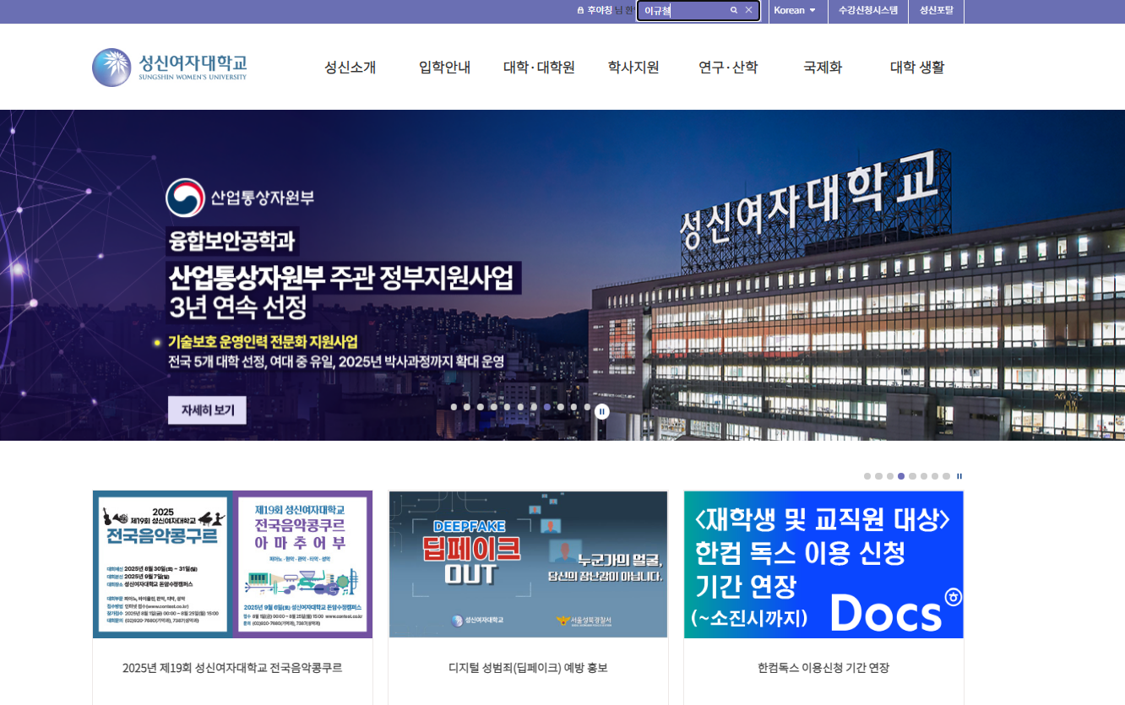
Enter the instructor’s name ( OR affiliated department ) here, then click search.

Slide 10
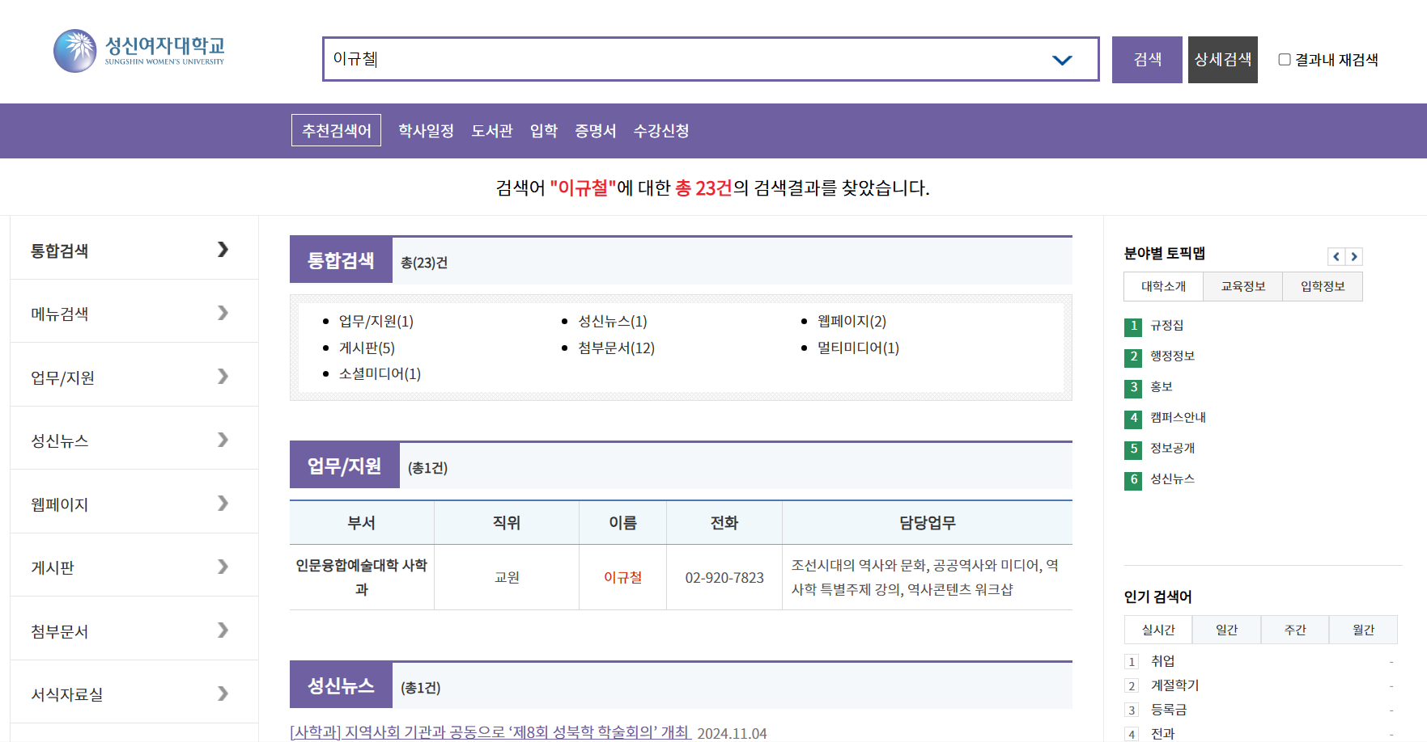
You can check messages related to the professor here, along with their affiliated department information.

Slide 11
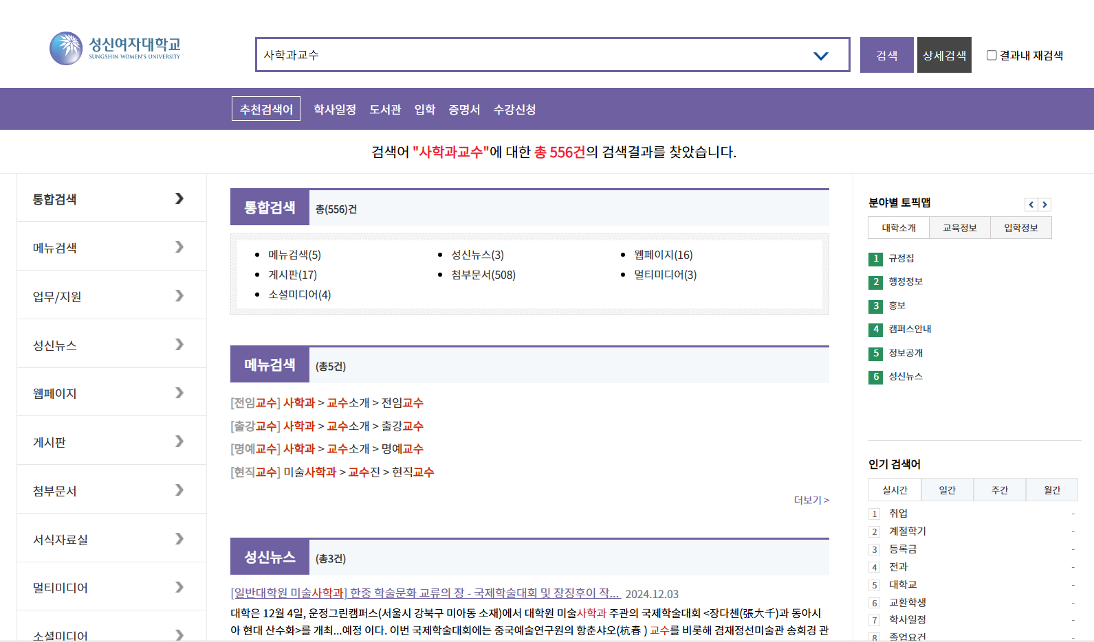
If you search again using the professor’s affiliated department
(e.g. 사학과교수), all related pages will be displayed below.

Slide 12
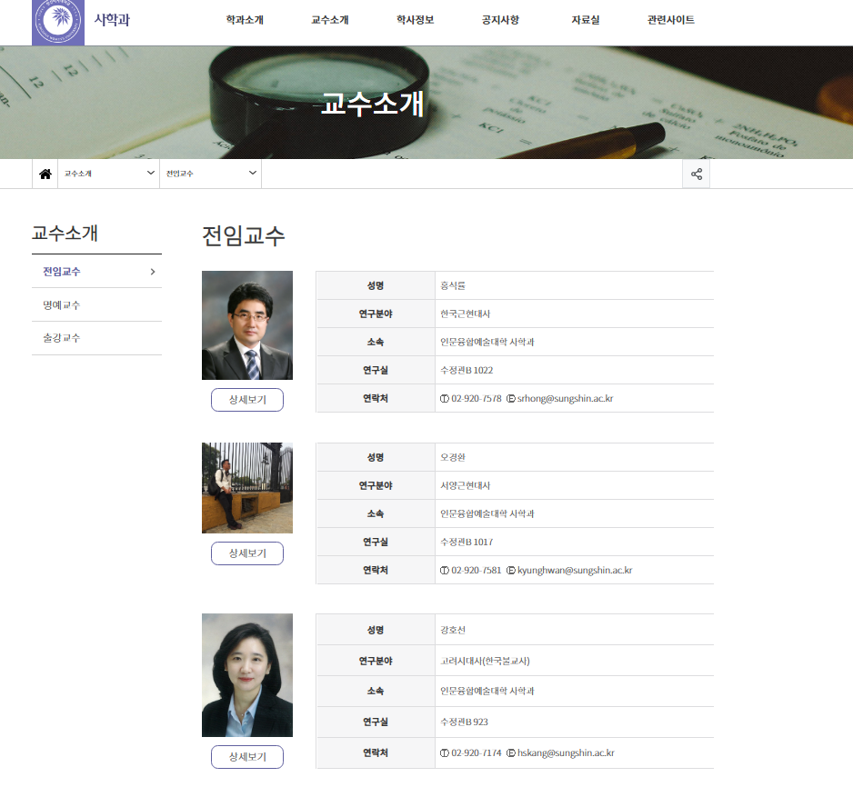
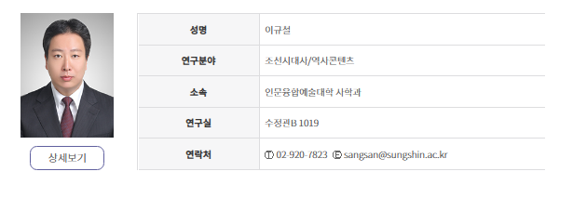
All information aboutprofessors in the affiliated department have been compiled below.

